Slide 1
MPLS LDP based LSR and LER using OpenFlow
Vikram Dham, Kamboi Technologies
Open vSwitch Fall 2014 Conference

Slide 2
About me
Present -
Co-Founder & CTO Kamboi Technologies
Working on exciting networking projects!
Past -
Sling Media
Built the core P2P software for connecting millions of boxes
UDP tunnels carrying video and control traffic
ECI Telecom, Avaya Research Labs, Raytheon, Nextone
802.11e EDCA & HCCA, WF2Q+, TCP Ack reconstruction in asymmetrical networks
MS Virginia Tech

Slide 3
Some things about the project..
Customer PoC
Explore MPLS LDP implementation using Open Flow
Built using Open Source components
Amazing how much code is in open source!
Notes:
Part of project being done for customer evaluating options for traffic engineering

Slide 4
Control basics
Centralized controllers – policies, traffic engineering
Peer to peer protocols such as BGP/LDP – Peering
Hybrid – Peer to peer + Centralized == Peering, Traffic Engineering & Policing
Work done by leading researchers to build Software Defined Exchanges (SDX)
Notes:
control basic –
nodes in center fine, but nodes on edge may still need to talk legacy protocols..
not a pure sdn world still
transition path is to be able to talk legacy protocols
researchers working on other legacy protocols using sdn such as bgp for ixps - software defined exchanges
at edge nodes may be interfacing with non sdn peers

Slide 5
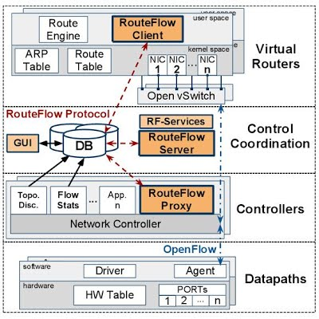
RouteFlow Architecture
Quagga running inside lxc containers
rfclient intercepts quagga netlink messages and sends to rfserver
rfserver – intelligence
rfproxy – light weight interface between rfserver & OF switches
RouteFlow Architecture [1]
Notes:
routeflow architecture
3 main layers
Rfproxy talks with the Of switch
Rfserver has mapping for quagga lxc ports and datapath ports
Rfclient listens to route updates from quagga
Allows reuse of all the work done by community to build opensource

Slide 6
MPLS 101
Incoming label based switching
NHLFE -> Next Hop Label Forwarding Entry
FTN -> FEC to NHLFE mapping
Advantages
Ability to install custom LSPs
Faster switching compared to longest prefix match
MPLS
IP
LER
LSR
LSR
LER
IP
11
IP
12
IP
12
IP
IP
FTN
IP | Label
NHLFE
11 | 12
NHLFE
12 | 14
NHLFE
14 | pop & route
Notes:
nhlfe
Ftn
Either use centralized path computation of something like ldp or both
We look into using ldp
faster switching, install custom paths

Slide 7
RouteFlow modifications to enable LDP
Quagga
Sends NHLFE & FTN using FPM
rfclient
Converts NHLFE & FTN to OF Flow Mods
rfserver
Maps vm id & port to dp_id & port and inserts into Of Flow Mods
rfproxy
Used Quagga ldpd implementation from [3]
Modifications
Enable user space Forwarding Plane Manager (FPM) interface
Send NHLFEs & FTNs to RouteFlow
ldpd config files
RouteFlow modifications
Forward LDP related traffic to CONTROLLER
Handle instructions for multiple tables
Handle mpls related Flow Mods
Used FIMSIM code from [4] for interfacing Quagga & RouteFlow using FPM
Notes:
mods to enable mpls ldp in routeflow
Quagga ldpd implemented by Renato Westphal
quagga changes
-listen for nhlfe & ftn updates and send using fpm to routeflow
-minimal changes to ldpd code
routeflow changes
--added support for instructions goto table
-- added support for mpls actions – push, pop, swap
use of userspace forwarding plane manager

Slide 8
LDP related Flow Entries
Send LDP traffic to Quagga lxc containers
UDP packets for saying HELLO
cookie=0x0, duration=3120.954s, table=2, n_packets=1869, n_bytes=142044, priority=32800,udp,tp_src=646,tp_dst=646 actions=CONTROLLER:65509
TCP packets for label exchange
cookie=0x0, duration=3120.955s, table=2, n_packets=341, n_bytes=27219, priority=32800,tcp,tp_dst=646 actions=CONTROLLER:65509
Notes:
install flowmods to handle ldp traffic of hello/label mapping exchange

Slide 9
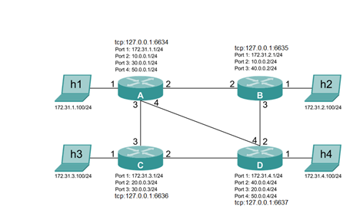
Demo test-bed
Quagga + ldp + FPM enabled
routeflow-vm
lxc instances running Quagga
rfvmA
rfvmB
rfvmC
rfvmD
rfproxy
mininet-vm
A
B
C
D
Notes:
describe demo testbed
Using ryu with OpenFlow 1.2
Open vSwitch code from the head of master 7c5d9f1
basically 2 vms one testbed running mininet and another running routeflow with 4 quagga instances running in lxc containers
proxy
rfserver mapping vm_id/vm_port -> dp_id & port
rfproxy very light weight send flow mods & packet outs and handle
packet ins

Slide 10
Demo Video

Slide 11
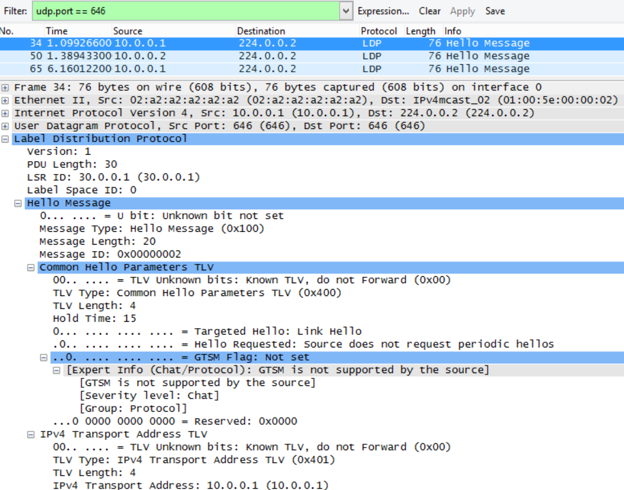
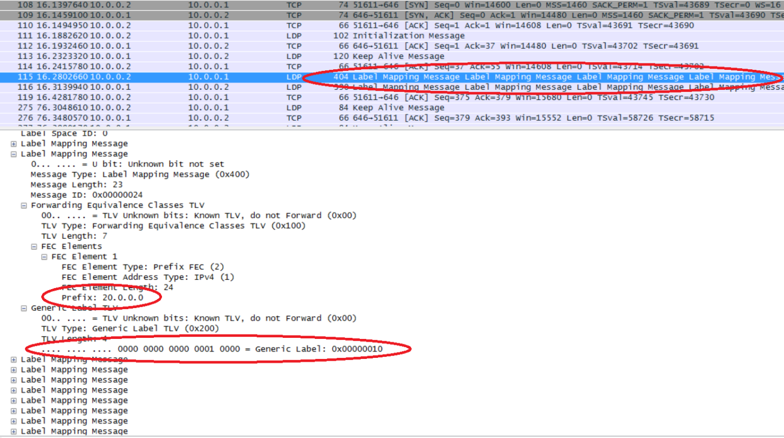
Sample LDP packet capture
LDP label mapping packets over TCP
LDP Hello packets over UDP
Notes:
show ldp wireshark capture
hello udp packets port 646 udp multicast - has advertised address and port ?
Show mpls label mapping exchange and periodic keep alive messages - packets port 646 tcp

Slide 12
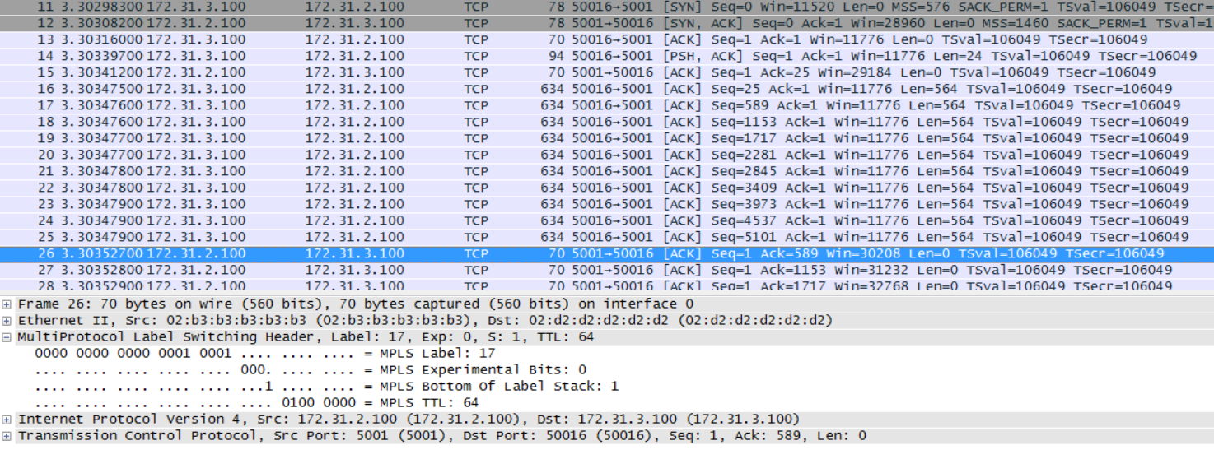
Sample MPLS packet capture
Packet capture of iperf traffic in the mpls network
Notes:
show mpls packet capture -
show mpls header and label

Slide 13
MPLS routing – multiple tables
table=0, mpls actions=goto_table:1
table=0, actions=goto_table:2
table=1, mpls,in_port=1,dl_dst=X,mpls_label=10 actions=set_field:Y->eth_src,set_field:Z->eth_dst,set_field:3->mpls_label,output:3
table=1, mpls,in_port=1,dl_dst=X,mpls_label=3 actions=pop_mpls:0x800,goto_table:2
…
…
table=2, priority=32700,ip,in_port=2,dl_dst=X,nw_dst=20.0.0.0/24 actions=set_field:Y->eth_src,set_field:Z->eth_dst,push_mpls:0x8847,set_field:5->mpls_label,output:3
table=2, priority=32700,ip,in_port=2,dl_dst=Y,nw_dst=40.0.0.0/24 actions=set_field:Y->eth_src,set_field:Z->eth_dst,push_mpls:0x8847,set_field:7->mpls_label,output:3
…
…
Notes:
discuss multiple tables table 0, 1, 2
show mpls pop, swap and push actions
show al l3 can be combined for lsr but not for ler as after pop need to go through ip flows
>>>>>>

Slide 14
LSR vs LER requirements
LSR can be implemented using a single table
Possible to combine table 0, table 1 & table 2
Possible to use commodity OF switches such as Pica8 which have basic mpls actions
LER needs support of multiple tables
Cannot combine table 1 & table 2
Use costlier OF switches which utilize FPGAs or NPU based pipelines
Or, push LER to software switches on the edge – software switch in hypervisor

Slide 15
Takeaways
More and more functionality to the edge
Software is eating hardware..
Keep as much intelligence & complexity as possible outside the core and push it to the edge!
Keep the code interfacing with the controller as light as possible
Software OF switch != Hardware OF switch
Need software tools for merging Flow Mods from different modules
Open Flow & Open vSwitch – Giant leap for networking
Helps avoid vendor lock in
Customer can pick (any 2 out of the 3) from the platter –speed, functionality, cost – ASIC, NPU, FPGA, software switches
Notes:
aligns with Guido's message yesterday --
Inteligence/complexity to the edge
Keep code interfacing with controller as light as possible

Slide 16
Yes, I want it..
Deploy in networks using OF switches
Integrate with custom traffic engineering algorithms
Use for educational/training purposes
Excellent content for learning – lxc, quagga, SDN controller, OF Mods
Open Source
https://github.com/vdham/RouteFlow
One touch build compiles and installs all the required components [Fear not the build process]
Base Ubuntu 12.04 + build command == RouteFlow Instance with OSPF + LDP

Slide 17
Thanks
Credits
James Liao±, Dr. Christian Esteve Rothenburg¥, Josh Bailey§, David Liu±, Joe Stringer^{φ}
^{± Pica8}
¥ University of Campinas (UNICAMP), Brazil
^{§ Google}
^{φ VMware}
References [TBD]
https://sites.google.com/site/routeflow
http://routeflow.github.io/RouteFlow
https://github.com/CPqD/RouteFlow/wiki
https://github.com/ofisher/fimsim
https://github.com/rwestphal/public-quagga

